Slide 1
Insights for Marketing Team in F&B
NITISH KASHINATH VIRAKTAMATH

Slide 2
Objective
To provide insights for Marketing Team based on survey responses by users of different cities
Files provided -:
dim_cities – Info about the cities along with their names and tiers
dim_respondents – Info about users
fact_survey_responses – Survey responses of users on energy drinks consumed
Tool used : Excel along with Pivot Table and Power Query

Slide 3
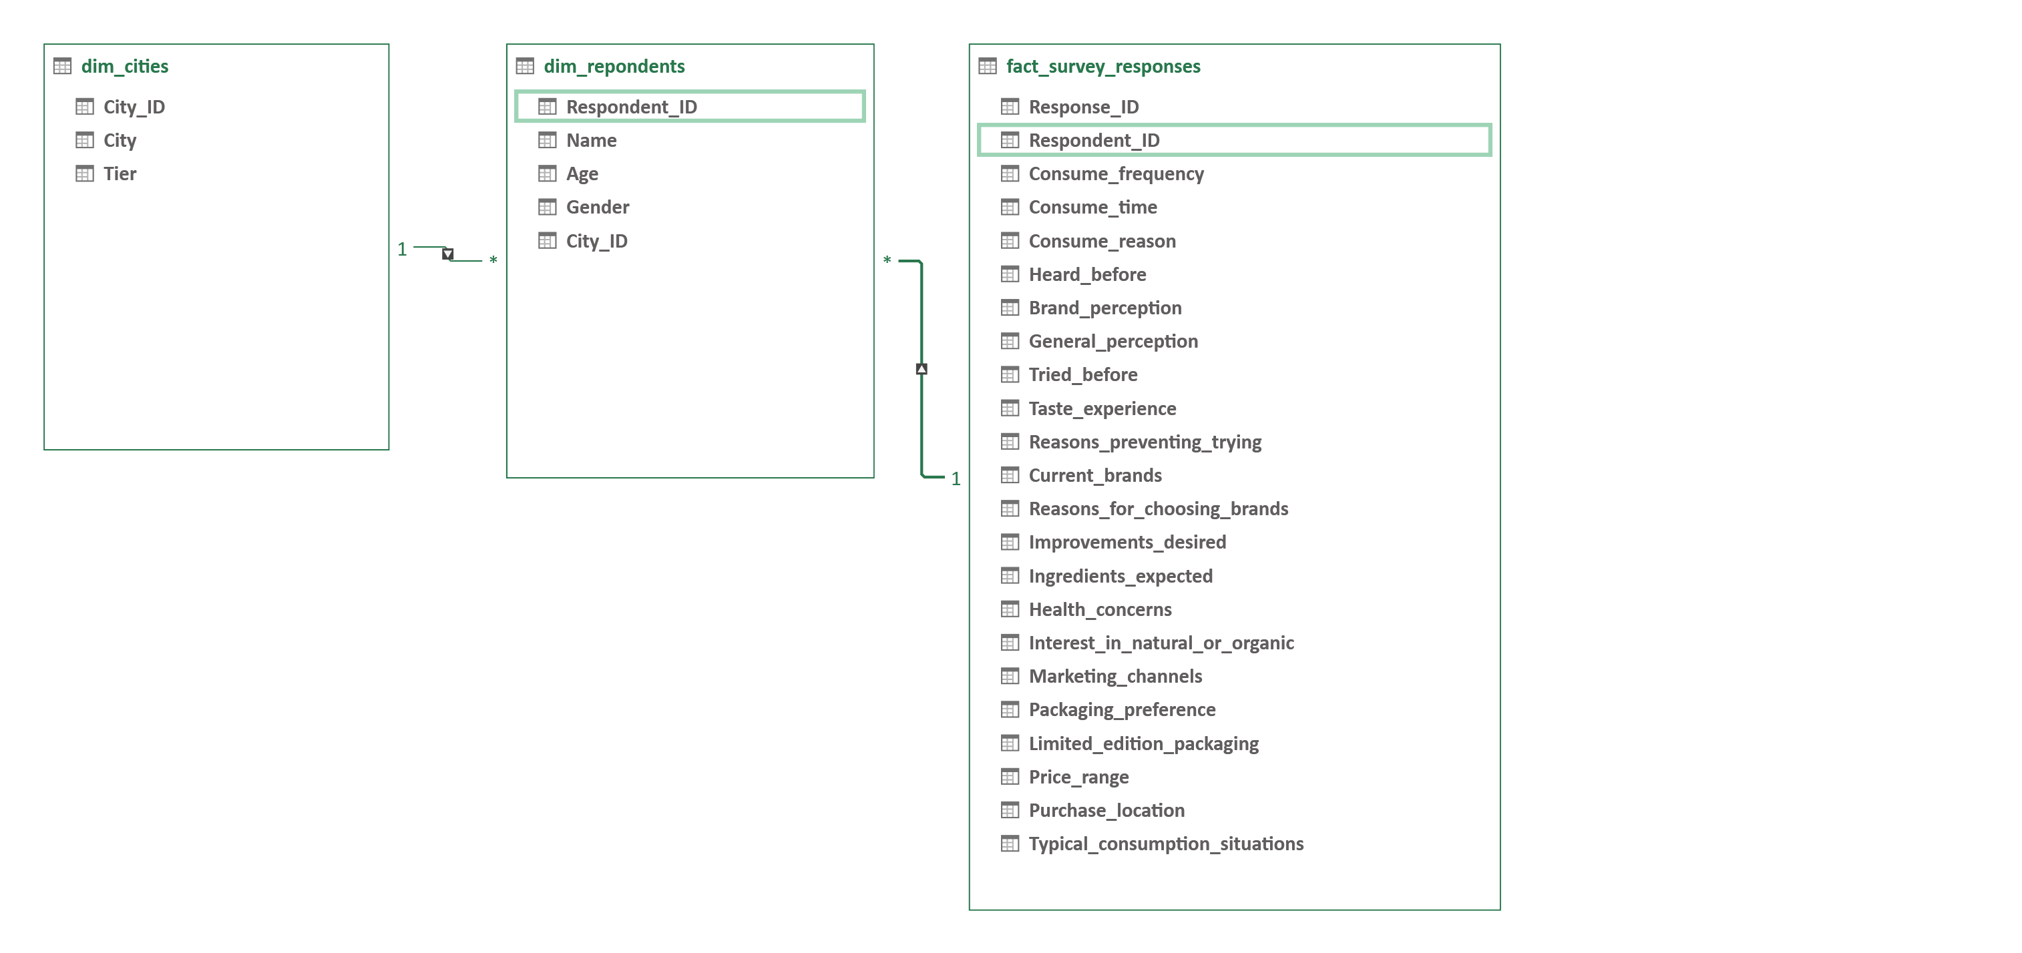
Pivot Table Diagram View
Relationships -:
dim_respondents – fact_survey_responses on Respondent_ID (Many to One)
dim_cities – dim_responses on City_ID (One to Many)

Slide 4
Data cleaning/Transformation
dim_cities – 10 rows:
The first row of the table is made the header row
City_id is changed from a numeric column to a text column
Table not found to have duplicate values/errors.
dim_respondents – 10,000 rows:
Respondent_id is changed from a numeric to text column
Duplicate values and errors are removed.
fact_survey_responses – 10,000 rows:
Respondents who have not heard about energy drinks but have tried before are removed from the table as people who have not heard about it would not try it.

Slide 5
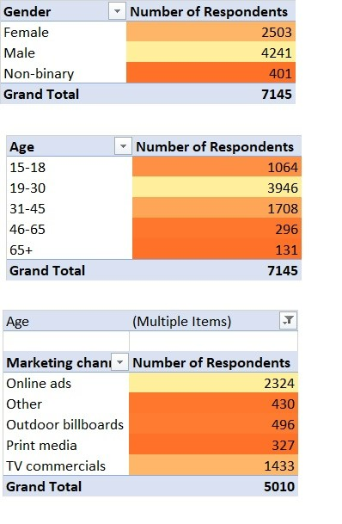
Demographic Insights
2-Scale Color coding used – Lighter shade refers to a higher numeric value
Males prefer energy drinks most – 4241 respondents
The Age group of 19-30 prefer energy drinks most – 3946 respondents
Online ads are the best medium to market for the youth(15-30) – 2324 respondents

Slide 6
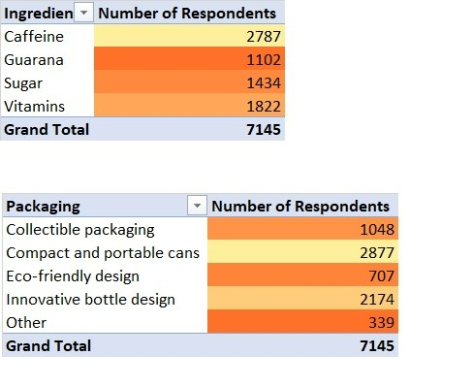
Consumer Preferences
Caffeine is the most preferred ingredient among respondents – 2787 respondents
Compact and portable cans is the most preferred packaging method – 2877 respondents

Slide 7
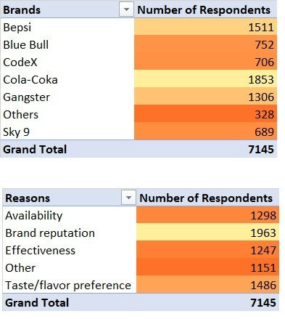
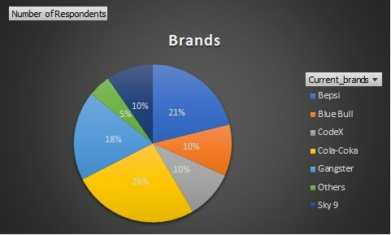
Competition Analysis
1.The current market leaders are Cola Coka and Bepsi with 26% and 21% of the market share respectively
2.Primary reasons for preference are Brand reputation and Taste/flavor preference.

Slide 8
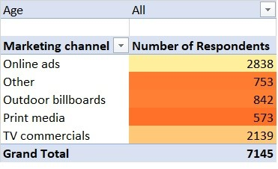
Marketing Channels and Brand Awareness
Online ads and TV commercials are the most effective marketing channels according to the respondents data
Our company can use more of Online ads and TV commercials to make our brand popular so that it is consumed more.

Slide 9
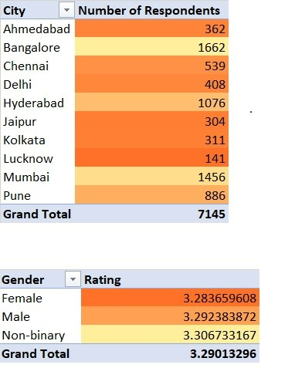
Brand penetration
The overall rating given by respondents is 3.29.
We need to focus more on the cities of Lucknow,Ahmedabad, Jaipur and Kolkata as they have the lowest number of respondents among other cities.

Slide 10
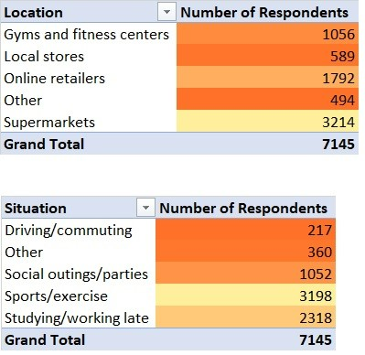
Purchase Behaviour
1.Respondents prefer to buy energy drinks at Supermarkets and Online retailers.
2.Respondents tend to consume energy drinks during Sports/exercise or during Studying/working late.

Slide 11
Product Development
We should focus more on Brand Reputation as maximum number of respondents stated that as the primary reason for choosing a brand.

Slide 12
Suggestions
We can make sure to add caffeine to our energy drinks and make them in compact portable cans.
50-99 would be the ideal price range for a can of energy drink
We can focus on Online Ads and TV Commercials to spread awareness about our products.
A popular celebrity can be brand ambassador as we try to reach more individuals mainly through Ads and TV Commercials.
Our target audience 15-30 as they consume drinks the most.

